Slide 1
Breast Cancer Detection using AdaBoost Classifier
Presented by
Team 4

Slide 2
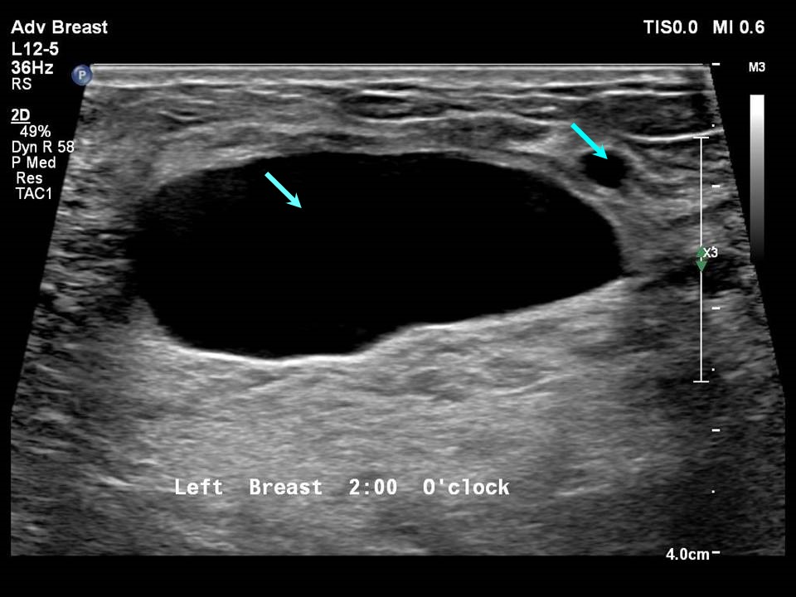
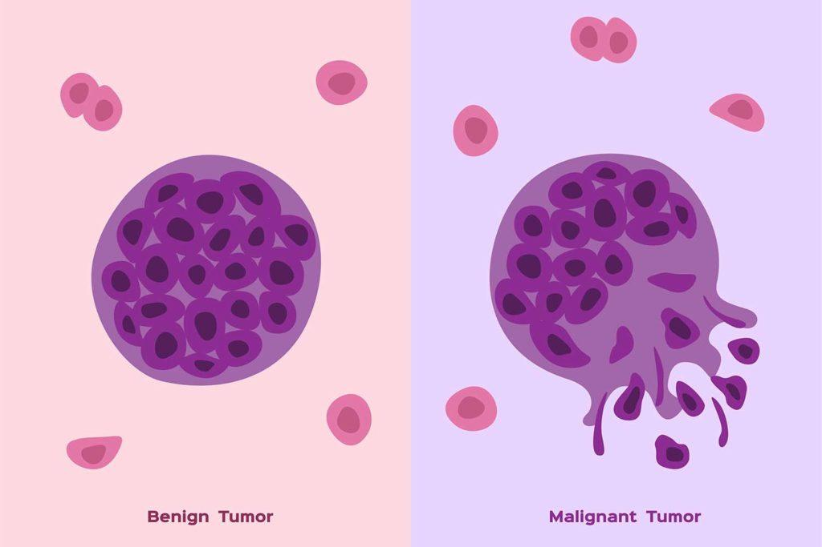
Introduction to Breast Cancer
The disease occurs when abnormal cells in the breast grow uncontrollably, forming a tumor. These tumors can be benign (non-cancerous) or malignant (cancerous).

Slide 3
Malignant Vs Benign
Malignant Tumor:
Cancerous
Aggressive
Metastasis
Life-threatening
Benign Tumor:
Non-cancerous
Slow-growing
No metastasis
Not life-threatening

Slide 4


Machine Learning in HealthCare
Disease Prediction and Diagnosis
Medical Imaging
Personalized Treatment Plans
Predictive Analytics

Slide 5


Why early detection of Breast Cancer is important?
Higher Survival Rates
Less Aggressive Treatment
Lower Risk of Metastasis
Reduced Healthcare Costs

Slide 6

Some Algorithms used to analyze medical data
Decision Trees
Random Forest
Support Vector Machines (SVM)
K-Nearest Neighbors (KNN)
Logistic Regression

Slide 7

Problem Statement
A project focused on detecting breast cancer using the AdaBoost classifier. To develop a machine learning model that accurately classifies breast cancer as either malignant or benign using the AdaBoost algorithm.

Slide 8

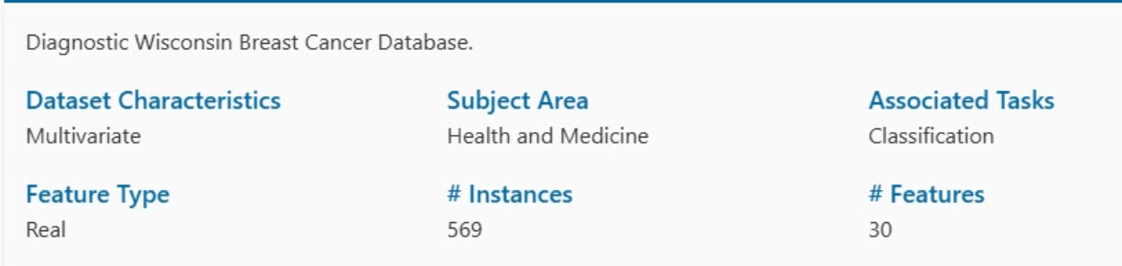
Data Collection
Collect and preprocess breast cancer data, typically sourced from the “UCI Breast Cancer Wisconsin dataset.”

Slide 9
Installing necessary libraries
Pandas
Seaborn
Matplotlib
Numpy
Sklearn

Slide 10
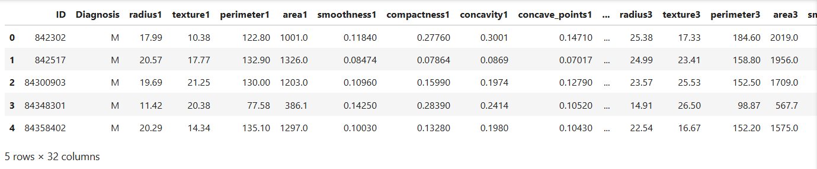


Reading the CSV file and naming the Columns
Analysis and Preprocessing of Dataset
Shape:
Number of duplicated rows:

Slide 11
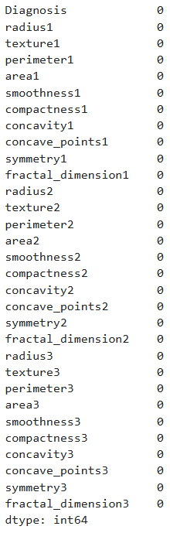
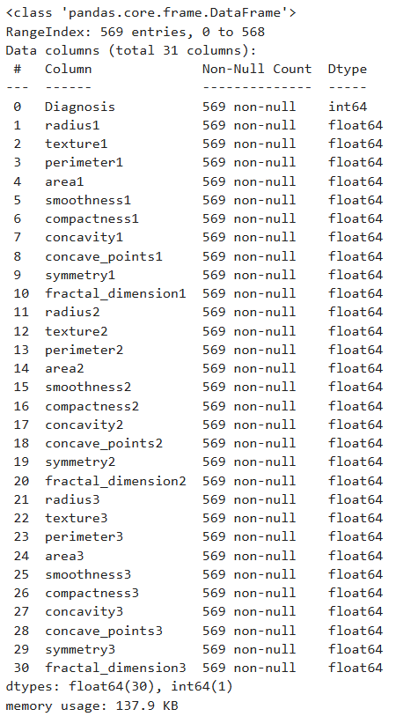
Number of NULL or missing values:
Analysis and Preprocessing of Dataset
info:
There is no missing or NULL values in our dataset

Slide 12
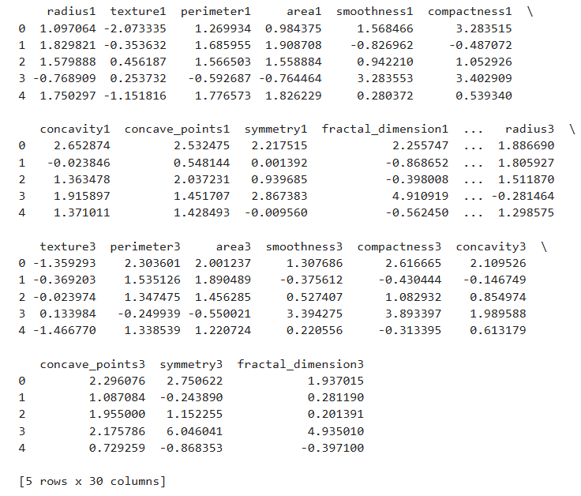
Scaling the data
By initializes a StandardScaler (from sklearn lib.) object which will standardize the features by removing the mean and scaling to unit variance.

Slide 13
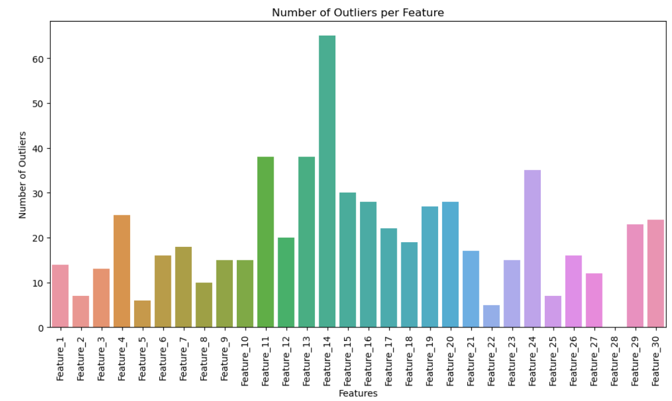
Data cleaning
Outlier Detection: Using IQR (Interquartile Range)
From our dataset we got around 171 outliers right now.
And removing the ID column which is not required for our Model

Slide 14
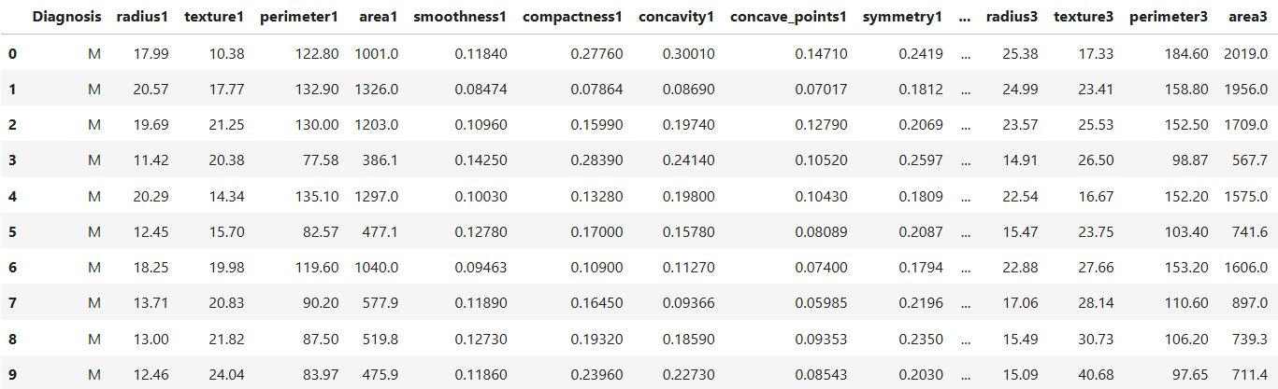
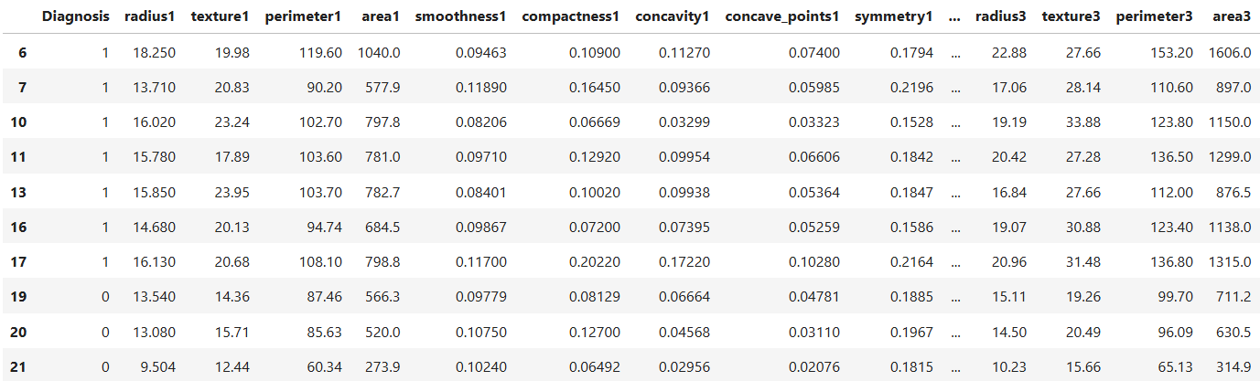
Encode categorical labels
Encoding categorical labels is important because:
Mathematical Interpretability
Model Compatibility
Improved Model Performance
Mapping
Malignant = 1
Benign = 0

Slide 15
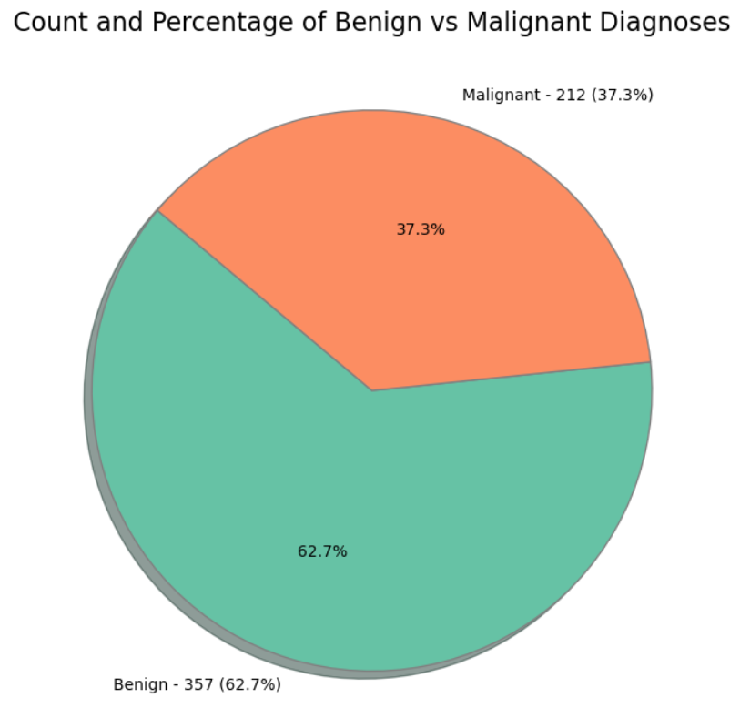
Data visualization
The given dataset is imbalanced which leads to
High False Negatives/Positives
Poor Performance on Minority Class
Misleading Evaluation Metrics
Percentage of benign cases = 62.7
Percentage of malignant cases = 37.3

Slide 16
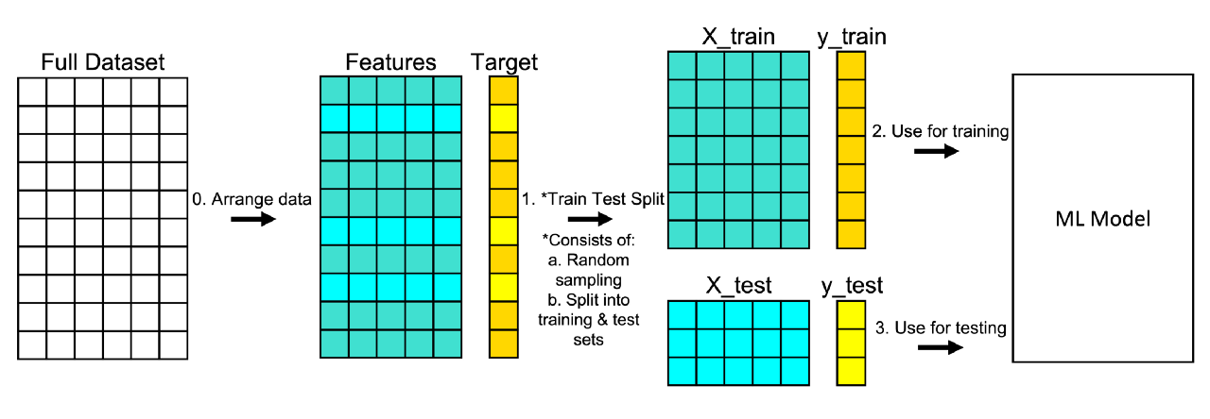

Data splitting
Before splitting Dataset
Shape of dataset:
After splitting Dataset
We have split the data with the ratio of 80:20

Slide 17
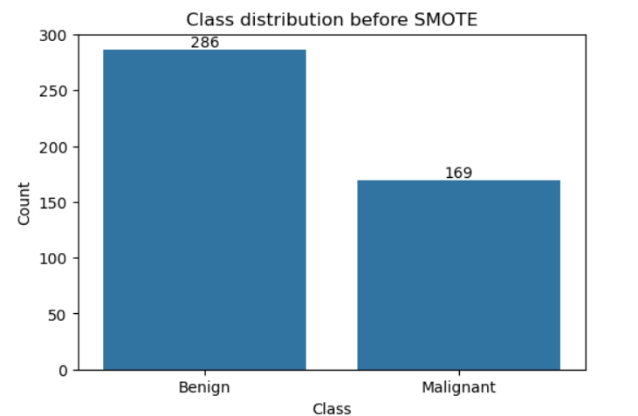
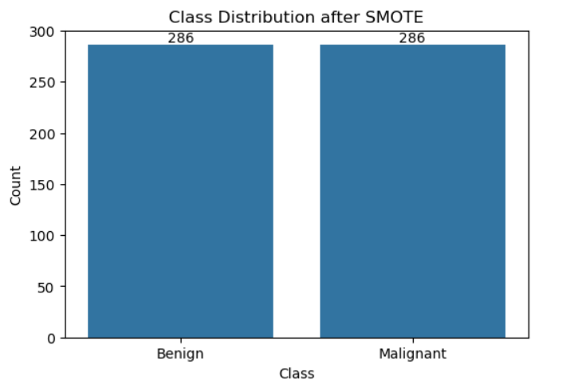
Synthetic Minority Over-sampling Technique, is a method used to handle imbalanced datasets.
Implementing SMOTE
SMOTE is implemented in train data after splitting the Original dataset.
not @test data

Slide 18
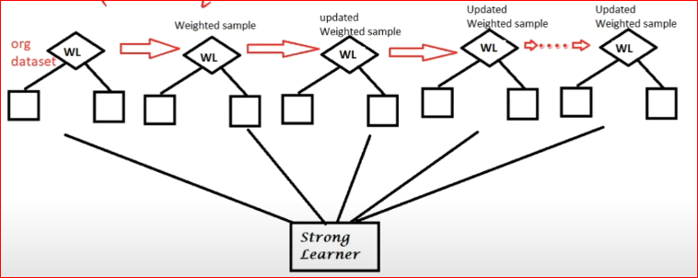
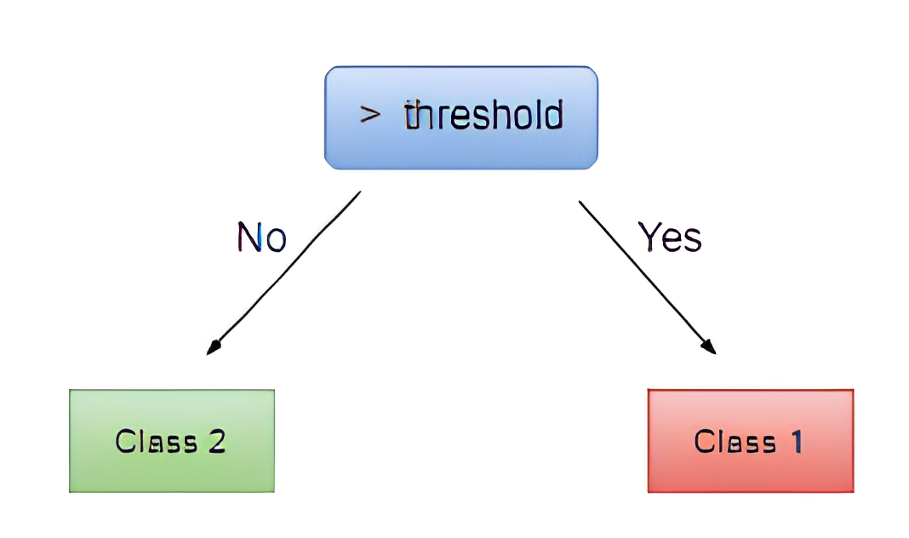
Implementation of ADABOOST Classifier
decision stump
AdaBoost (Adaptive Boosting) is a popular ensemble method that improves the performance of weak learners, typically decision trees, by combining multiple models into a single, strong model.
We use scikit-learn to implement Adaboost in our dataset

Slide 19
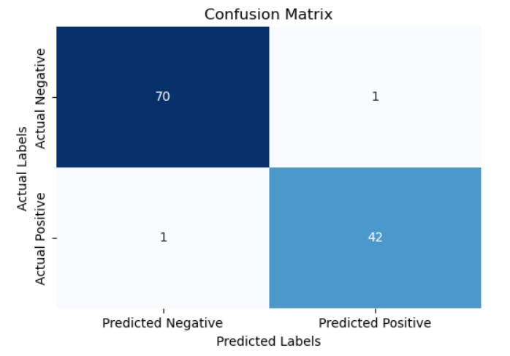
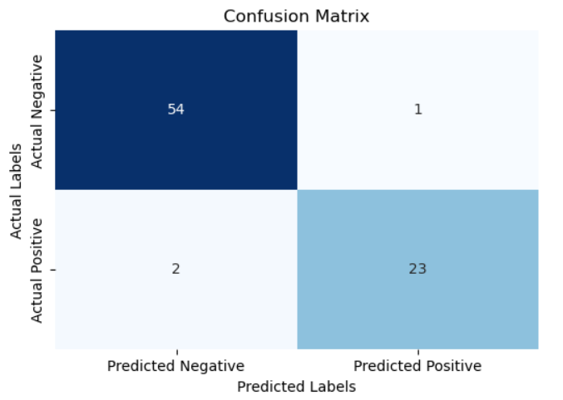
Confusion Matrix
WITH Outlier
WITHOUT Outlier
The WITH Outlier model has higher recall with fewer false negatives, making it slightly better at identifying positive cases than WITHOUT Outlier.

Slide 20


Performance Evaluation
In our Dataset we have, we TRAINED the model with and without outliers
WITH Outlier
WITHOUT Outlier
In our case the Performance reduced after removing outliers

Slide 21

Importance of Recall and Precision in Medical Diagnosis
In breast cancer detection, recall is critical to ensure cancer cases aren’t missed, as false negatives could delay treatment.
Precision also matters to reduce false positives, minimizing unnecessary anxiety and tests.
The F1 score provides a balanced measure, combining both precision and recall.

Slide 22
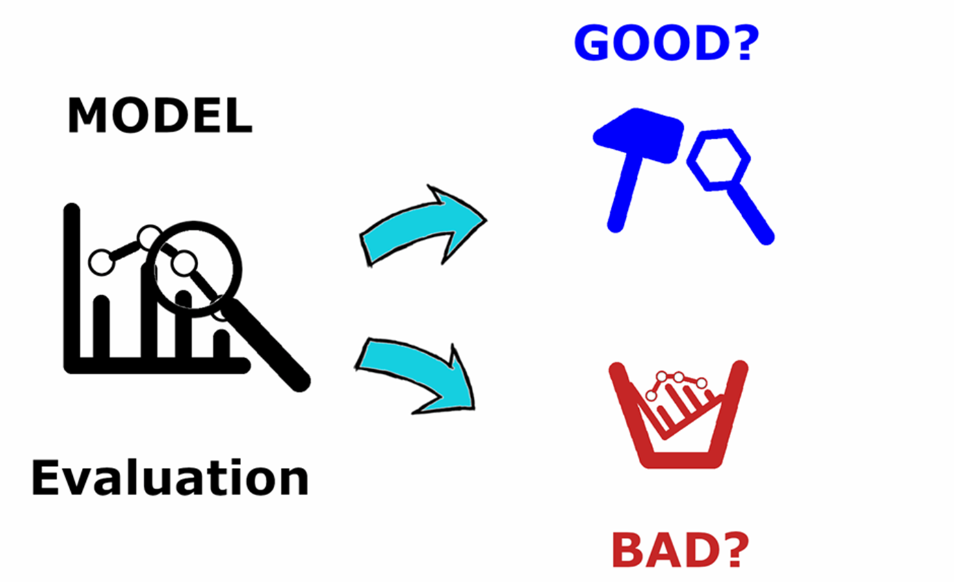
Balancing Precision and Recall
High Precision, Low Recall: This might mean that while most positive diagnoses are accurate, some actual cases are missed (high false negatives).
High Recall, Low Precision: Most actual cases are identified, but with a risk of many false positives, leading to unnecessary treatments.

Slide 23
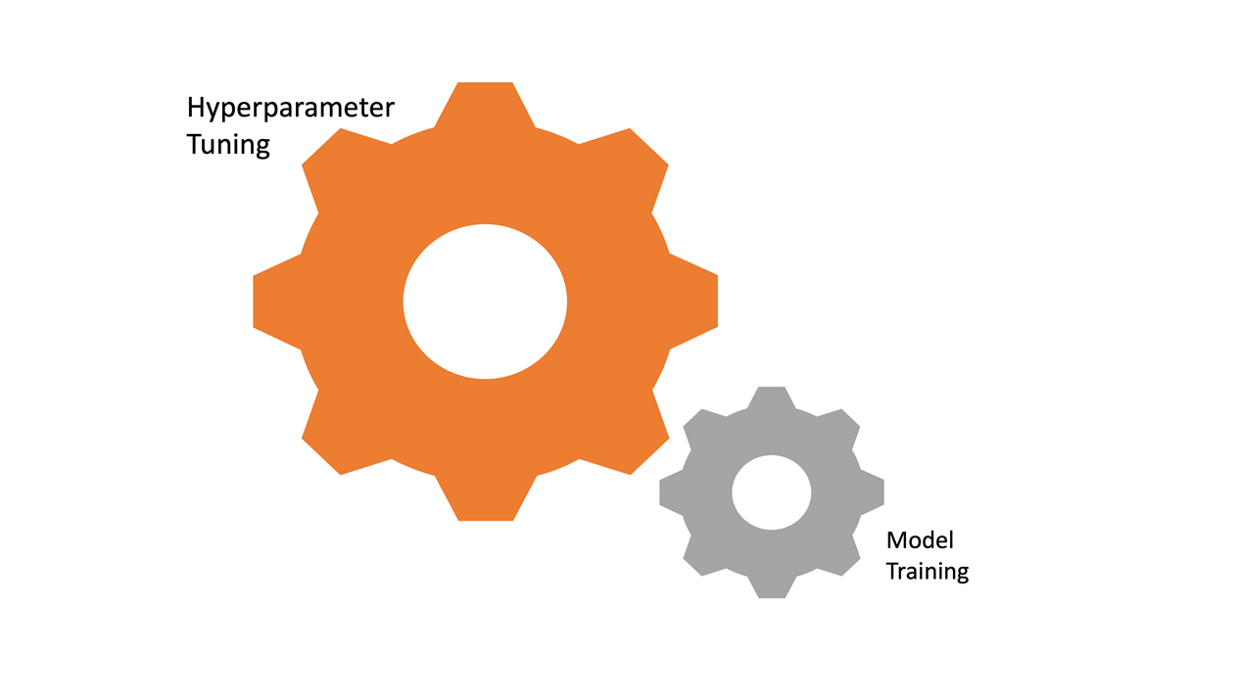
Hyperparameter Tuning
Parameters for the AdaBoost classifier are estimators, learning rate, and maximum depth of the base estimator.
Used GridSearchCV to test combinations of parameters with 5-fold cross-validation, optimizing for accuracy.
Identified the best combination of hyperparameters based on performance metrics.

Slide 24
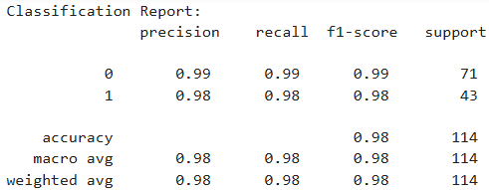
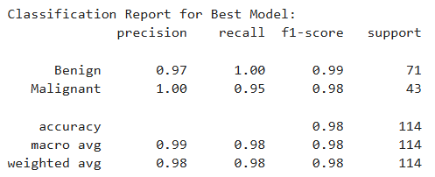
Score before and after hyper tuning
Our Classification Report has been improved after hyper tuning
BEFORE
AFTER

Slide 25

Presented by TEAM-4
Sayyed Nizar M
A.V.K Sai Surya
Bala Sairam Goli
Jayam V

